Slide 1
House Prices:
Advanced Regression Techniques
Predicting Ames housing price
using machine learning algorithms
Team Stack Underflow
Mengran Jessie Cui
Chloe Moon
Lilian Yuan
NYC Data Science Academy
July 28, 2019

Slide 2
Agenda
01
Background
Origin of dataset, categorical vs. numerical variables, objective
02
Data Exploration, Cleaning, and Transformation
Missing values, skewness, multicollinearity, feature importance
03
Predictive Models
Ridge, Lasso, ElasticNet, LightGBM, XGBoost, GDBoost, Random Forest
04
Results and Conclusion
Stacking models, Kaggle results, Thoughts, and Q&A

Slide 3
Agenda
01
Background
Origin of dataset, categorical vs. numerical variables, objective
02
Data Exploration, Cleaning, and Transformation
Missing values, skewness, multicollinearity, feature importance
03
Predictive Models
Ridge, Lasso, ElasticNet, LightGBM, XGBoost, GDBoost, Random Forest
04
Results and Conclusion
Stacking models, Kaggle results, Thoughts, and Q&A

Slide 4
Ames Housing Dataset
01
02
The Data
Origin
20 continuous variables (numerical)
Related to various area dimensions
Compiled by Dean De Cock for use in data science education
A modern and expanded alternative to Boston Housing dataset.
14 discrete variables (numerical)
Quantify the number of items occurring within the house
23 nominal variables (categorical)
Identify various types of dwellings, garages, materials, and environmental conditions
23 ordinal variables (categorical)
Rate various items within the property

Slide 5
03
Objective
Predict housing price by:
Data Exploration and Visualization
Data Cleaning and Transformation
Machine Learning Algorithms

Slide 6
Agenda
01
Background
Origin of dataset, categorical vs. numerical variables, objective
02
Data Exploration, Cleaning, and Transformation
Missing values, skewness, multicollinearity, feature importance
03
Predictive Models
Ridge, Lasso, ElasticNet, LightGBM, XGBoost, GDBoost, Random Forest
04
Results and Conclusion
Stacking models, Kaggle results, Thoughts, and Q&A

Slide 7
Data Exploration, Cleaning, Transformation and Engineering
Tackling various issues with raw dataset
“In Data Science, 80% of time spent prepare data, 20% of time spent complain about need for prepare data.”
Sales price:
Has outliers & skewed
Correlation and multicollinearity
There are a large number of missing values.
Values are missing for various reasons
01
02
03
Some numerical variables are highly skewed
Feature importance
Data engineering
04
05
06

Slide 8
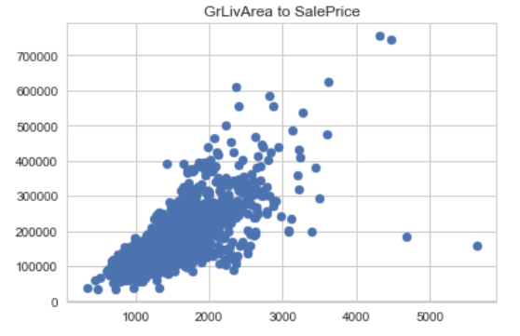
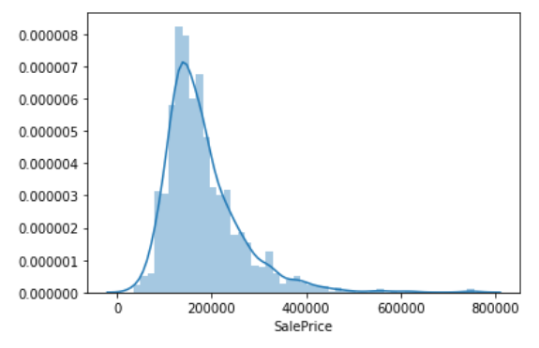
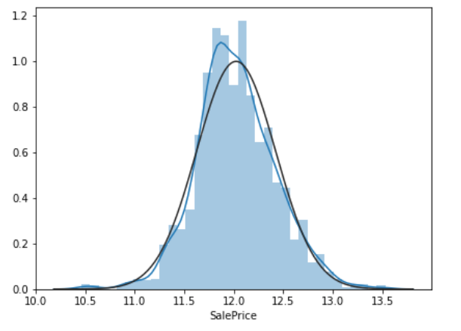
Data Exploration, Cleaning, Transformation and Engineering
Issue:
Sales price (response variable) has outliers
Distribution of sales price is skewed
01
Solution:
Remove outliers
Take log(Sales Price)

Slide 9
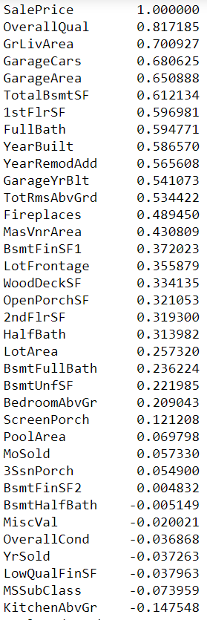
Data Exploration, Cleaning, Transformation and Engineering
Task:
Understand correlation and multicollinearity
02
Solution 1:
Calculate correlation between Sales Price and variables

Slide 10
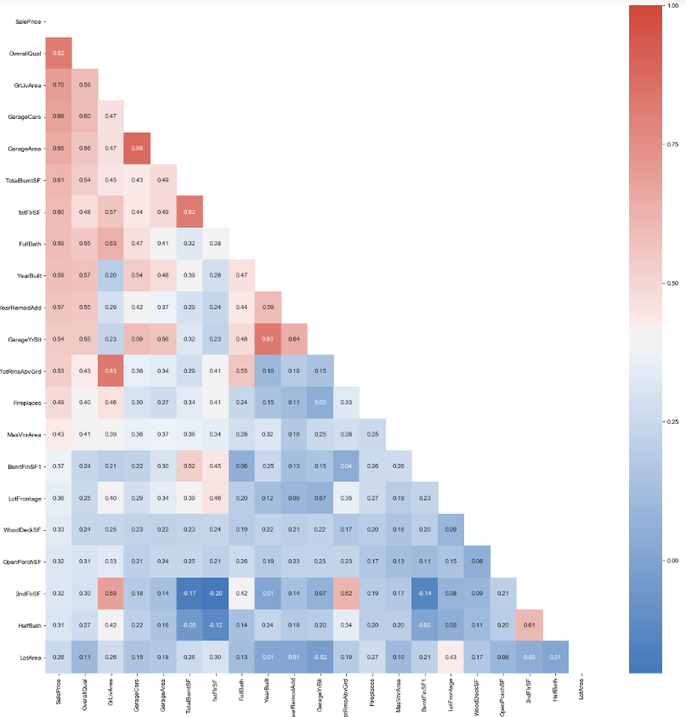
Data Exploration, Cleaning, Transformation and Engineering
Task:
Understand correlation and multicollinearity
02
Solution 2:
Correlation heatmap

Slide 11
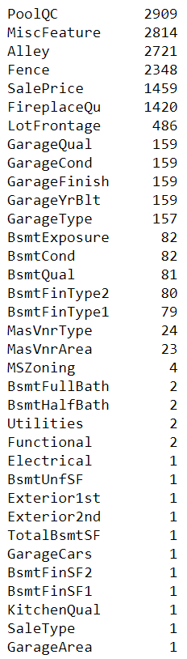
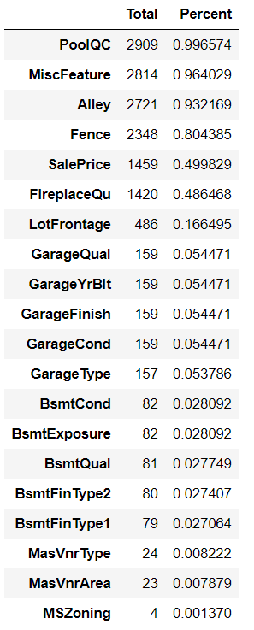
Data Exploration, Cleaning, Transformation and Engineering
Issue:
Lots of missing values
03

Slide 12
Data Exploration, Cleaning, Transformation and Engineering
Issue:
Lots of missing values
Solution:
Identify the reason for missing
Fill in missing values to the best judgments
03
NaN = None (categorical)
NaN = Assume it is typical
Still missing?
Based on data description, NaN actually means there is none (or 0). Fill in NaNs with None.
Example variable(s):
'GarageType', 'GarageFinish', 'GarageQual', 'GarageCond','BsmtQual’, 'BsmtCond', 'BsmtExposure', 'BsmtFinType1’ etc.
Based on data description, NaN actually means it belongs to the category “typical”.
Example variable(s):
‘Functional’
Observe how many NaNs are there
Luckily, there are very few missing (<5%) for each of the variables that still have missing values.
We filled in by taking the most common value.
Example variable(s):
'Exterior1st','Exterior2nd','SaleType','Electrical','KitchenQual’
NaN = 0 (numerical)
We can impute from existing data
Based on data description, NaN actually means there is none (or 0). Fill in NaNs with 0.
Example variable(s):
'GarageYrBlt’,'GarageArea’,'GarageCars','MasVnrArea','BsmtFinSF1','BsmtFinSF2','BsmtFullBath','BsmtHalfBath','FullBath','HalfBath’ etc.
‘LotFrontage’ is dependent on the zoning district in which a property is located (i.e. ‘Neighborhood’)
Group by neighborhood & LotArea and fill in missing value by the median LotFrontage of each neighborhood.
Example variable(s):
‘LotFrontage’, ‘MSZoning’
Result:
No missing values now!

Slide 13
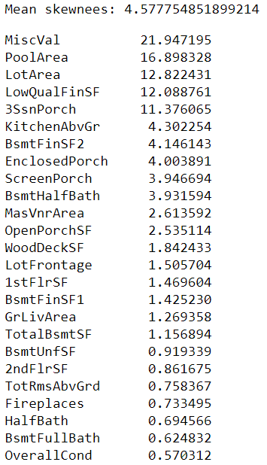
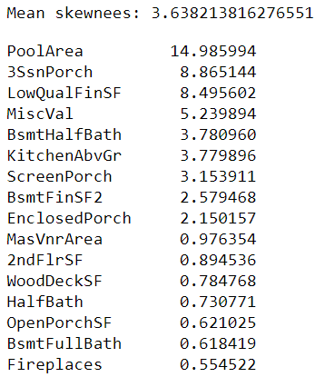
Data Exploration, Cleaning, Transformation and Engineering
Issue:
Some numerical variables are highly skewed
Solution:
Box Cox transformation
04
Check for numerical features where
skewness is > 0.5
abs(skewness)>1： highly skewed
1 > abs(skewness) > 0.5： moderately skewed
Taking conservative approach and adjusting for
moderately skewed
16 highly-moderately skewed numerical variables
25 highly-moderately skewed numerical variables

Slide 14
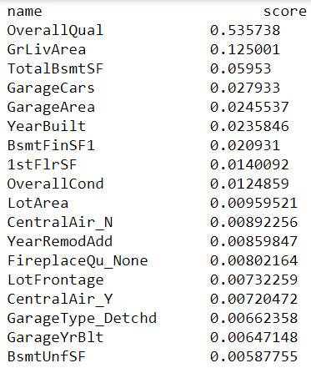
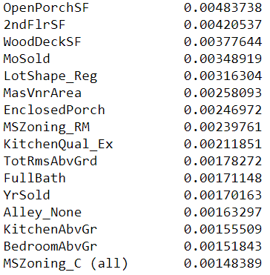
Data Exploration, Cleaning, Transformation and Engineering
Task
Understand feature importance
05
Solution:
Run RF algorithm and observe feature importance

Slide 15
Data Exploration, Cleaning, Transformation and Engineering
Task:
Data engineering
We see high correlations between variables that are related to areas/SF
Solution:
Create new area/SF related variables
06
‘TotalBsmtSF’ ‘1stFlrSF’ ‘2ndFlrSF’
‘Total SF’
‘FullBath’ ‘HalfBath’ * 0.5 ‘BsmtFullBath’ ‘BsmtHalfBath’*0.5
‘Total Bathrooms’
‘OpenPorchSF’ ‘3SsnPorch’ ‘EnclosedPorch’ ‘ScreenPorch’ ‘WoodDeckSF’
‘Total Porch’

Slide 16
Data is cooked and ready!
Let the modeling begin…

Slide 17
Agenda
01
Background
Origin of dataset, categorical vs. numerical variables, objective
02
Data Exploration, Cleaning, and Transformation
Missing values, skewness, multicollinearity, feature importance
03
Predictive Models
Ridge, Lasso, ElasticNet, LightGBM, XGBoost, GDBoost, Random Forest
04
Results and Conclusion
Stacking models, Kaggle results, Thoughts, and Q&A

Slide 18
Machine Learning Models Candidates:
Linear modeling
Non-Linear modeling
Ridge
01
Regularized linear regression
Random Forest
Gradient Boosting (GDBT)
04
05
Ensemble a group of simple and weak models and making predictions using the weighted average of their output
Decision Tree model
Use a random subset of features at each split
Lasso
02
Regularized linear regression
Allows feature selection
XGBoost
LightGBM
06
Extreme GDBT
Leaf-wise growth strategy
Pre-sorted algorithm & histogram-based algorithm to find best split.
Faster speed and improved accuracy
07
A subtype of GDBT
Leaf-wise growth strategy
Gradient-based one-side sampling
Exclusive feature bundling
Faster speed and improved accuracy
Elastic Net
03
Regularized linear regression
Hybrid of Ridge & Lasso

Slide 19
Machine Learning Models Candidates:
Model Type | Pro | Con
Ridge | Easily interpretable, computationally efficient | Not very robust to outliers
Lasso | Easily interpretable, computationally efficient, have feature selection functionality | Not very robust to outliers
ElasticNet | Easily interpretable, versatile for L1 and L2 regularization | Not very robust to outliers, can be over-regularized
Random Forest | Deals well with large number of features, very convenient when dealing with categorical variables, provides good info | Computationally intensive, underpowered for complex data
Gradient Boosting | High out-of-box performance | Easy to overfit
XGBoosting | High out-of-box performance, faster computation | Easy to overfit
LightGBM | High performance, faster to train, faster computation | A lot of hyperparameter optimization and tuning, overfitting

Slide 20
Stack the models

Slide 21
Machine Learning Models Used:
 | Reg Regression Auto Parameter |  |  | Parameter Fine Tuning
 | Mean CV RMSE | Model score | RMSE | Mean CV score | Model score | RMSE
Ridge | 0.1080 | 0.9456 | 0.09319 | 0.1080 | 0.9440 | 0.094511
Lasso | 0.1116 | 0.9295 | 0.1061 | 0.1067 | 0.9405 | 0.09742
ElasticNet | 0.1116 | 0.9295 | 0.10611 | 0.1067 | 0.9405 | 0.09742
Gradient Boosting | 0.1143 | 0.9843 | 0.05008 | 0.1143 | 0.9741 | 0.05008
XGBoost | 0.1117 | 0.9846 | 0.04951 | 0.1117 | 0.9846 | 0.04952
LightGBM | 0.1128 | 0.9741 | 0.06428 | 0.1129 | 0.9842 | 0.0648
Random Forest | 0.1415 | 0.9762 | 0.06159 | 0.1457 | 0.9764 | 0.06139
Notes:
Results similar – decided to use fine tuning
Results for Lasso and ElasticNet are the same,
So thought of removing ElasticNet

Slide 22
Experiments
Approach | Stacking RMSE on Train Data | Stacking RMSE on Test Data from Kaggle
StakingRegressorCV With Elastic Net | 0.07481 | 0.11685
StakingRegressorCV Without elastic net | 0.0685 | 0.11582
Averaging Predictions With Elastic Net | 0.06716 | 0.11736
Averaging Predictions Without Elastic Net | 0.06263 | 0.11798
Weighing by inverse RMSE With Elastic Net | 0.0666 | 0.11743
Weighing by inverse RMSE Without Elastic Net | 0.06218 | 0.11806

Slide 23
Agenda
01
Background
Origin of dataset, categorical vs. numerical variables, objective
02
Data Exploration, Cleaning, and Transformation
Missing values, skewness, multicollinearity, feature importance
03
Predictive Models
Ridge, Lasso, ElasticNet, LightGBM, XGBoost, GDBoost, Random Forest
04
Results and Conclusion
Stacking models, Kaggle results, Thoughts, and Q&A

Slide 24
Results
Further Improvement Areas
Kaggle test RMSE 0.11582
Kaggle position at # 648/4353 = 14.88% (~ top 15%) as of July 30, 2019
Explore more on feature engineering / addition of more features
More time further tuning the hyperparameters
Attempts and Thoughts
We attempted to use random forest to impute missing values, but this did not improve our results. This is likely due to overfitting problem given our small data size.
Data engineering with new combined variables does not necessarily give us better prediction results.
Stacking models gave us better results than stand-alone models.
Machine learning requires lots of trials and errors at each step of the process.

Slide 25
Thank you!

